Slide 1
Servlets DATABASE

Slide 2
Create Database in netbeans
Expand “Database”
Right click “Java DB”, and select “Create Database”.
In the Create JavaDB Database window provide the database name, user name, and password.
When you have created a DBMS, a series of files will be created in your user space as will be described below.

Slide 4
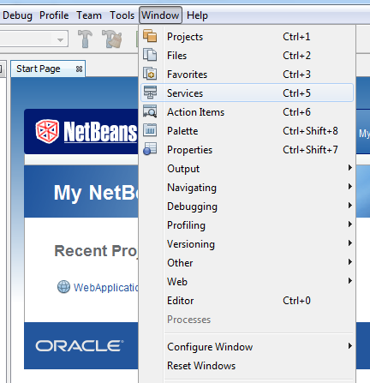

Slide 5
Create Database

Slide 6
Servlet code to access data base
String connectionURL = "jdbc:derby://localhost:1527/arun";
try {
Connection conn = DriverManager.getConnection(connectionURL, "vit", "vit");
out.println("Connect successfully ! ");
String sql = "SELECT * FROM TEST";
Statement st = conn.createStatement();
ResultSet rs=null;
rs=st.executeQuery(sql);
while(rs.next()){
out.println(rs.getInt("id")+"\t"+rs.getString("name"));
}
rs.close(); st.close(); conn.close();
} catch (SQLException ex) {
out.println("Connect failed ! ");
}

